Slide 1
Data Structures and Algorithms -3 (25CS2103E)
High Performance Medical Information Search System
Team Member | Roll Number
Vaishali | 2520030117
Bindhu Madhavi | 2520030077
Sri Kruthi | 2520030340
Under the Esteemed Guidance of
S.Madhavi

Slide 2
Contents
Abstract
Introduction
Literature survey
Problem Statement and Objectives
Hardware and Software requirements
Results
Conclusion
Future Scope

Slide 3
Abstract
The High-Performance Medical Information Search System is designed for fast retrieval of medical information.
The system contains a medical corpus with 100 medical records and a database of 2,000 patient records.
Users can search medical information using keywords such as diseases, symptoms, and conditions.
KMP, Z-Function, and Rabin-Karp algorithms are used for string searching.
Dynamic Programming techniques such as Edit Distance and LCS are also implemented.
The system also performs patient symptom searching and displays matching patient records.
The main objective is to provide fast and efficient medical information retrieval.

Slide 4
Introduction
Medical datasets contain a large amount of information about diseases, symptoms, and patient conditions.
Searching this information efficiently is important for quick retrieval of relevant records.
Our system provides keyword-based searching over medical records.
It also includes Dynamic Programming techniques for additional text-processing and optimization operations.
A patient database containing 2,000 generated patient records is used for symptom-based searching.
The system demonstrates how Data Structures and Algorithms can be applied to a real-world medical search problem.
The project uses advanced string-matching algorithms such as KMP, Z-Function, and Rabin-Karp.

Slide 5
Literature Survey
1. Literature Survey — 4 Recent Papers
S.No. | Research Paper | Year | Main Contribution
1 | Clinical Information Retrieval: A Literature Review – Sivarajkumar et al. | 2024 | Reviews clinical information retrieval methods and techniques for searching medical information.
2 | Large Language Models to Process, Analyze, and Synthesize Biomedical Texts – Doneva et al. | 2024 | Studies LLMs for biomedical text processing, knowledge management, text mining and evidence synthesis.
3 | BiomedRAG: A Retrieval Augmented Large Language Model for Biomedicine – Li et al. | 2025 | Uses retrieval techniques to obtain relevant biomedical information for biomedical NLP tasks.
4 | Evaluating Search Engines and Large Language Models for Answering Health Questions – Fernández-Pichel et al. | 2025 | Compares search engines, LLMs and RAG approaches for health-related questions.

Slide 6
Problem Statement and Objectives
Problem Statement
Medical information can contain a large number of records.
Finding relevant information manually can take more time.
Simple searching becomes less efficient as the data increases.
A fast and efficient medical information search system is required.
Objectives
Develop a High-Performance Medical Information Search System.
Search medical records using user-entered keywords.
Implement KMP, Z-Function and Rabin-Karp algorithms.
Search patient records based on symptoms.
Apply Dynamic Programming techniques.
Retrieve relevant medical information quickly and efficiently.
Your implementation contains 100 medical records and 2,000 patient records.

Slide 7
Flow Chart
START
Load Medical Records and Patient Database
Enter Medical Keyword
Search Medical Records using KMP
Match Found?
Yes → Z-Function + Rabin-Karp Verification
Patient Symptom Search
Dynamic Programming Processing
Display Search Results
END

Slide 8
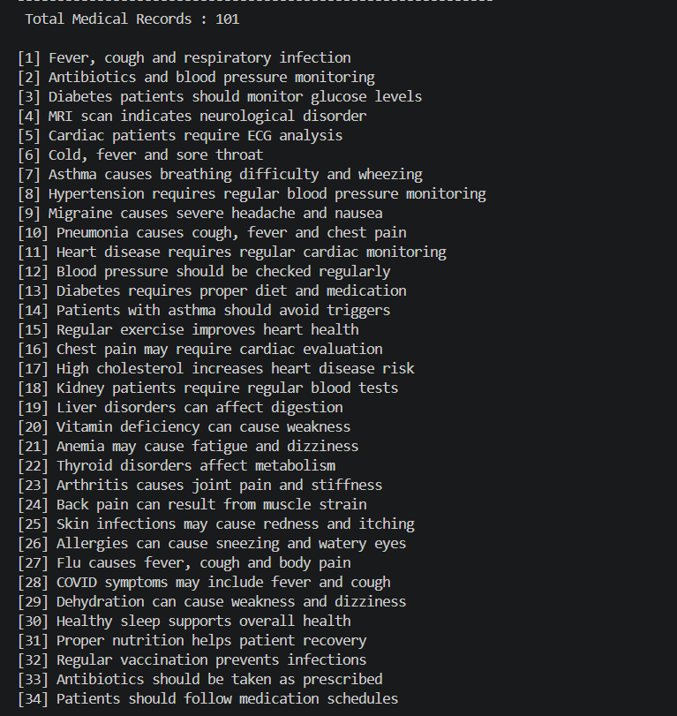
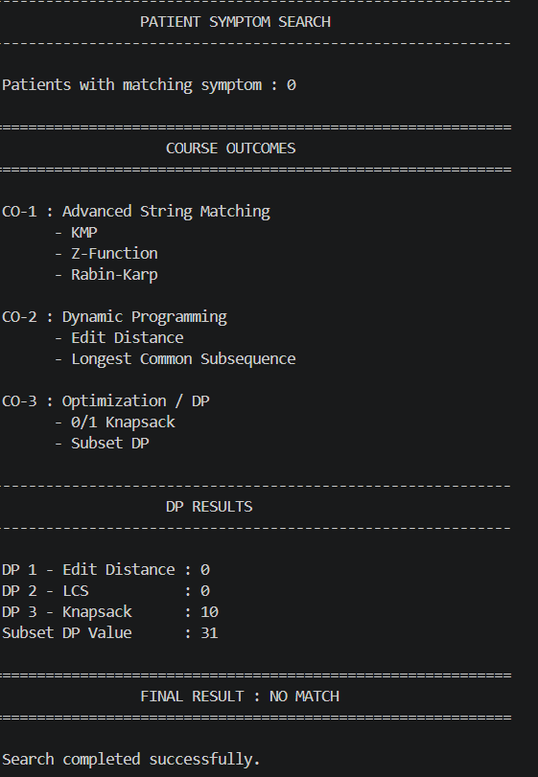
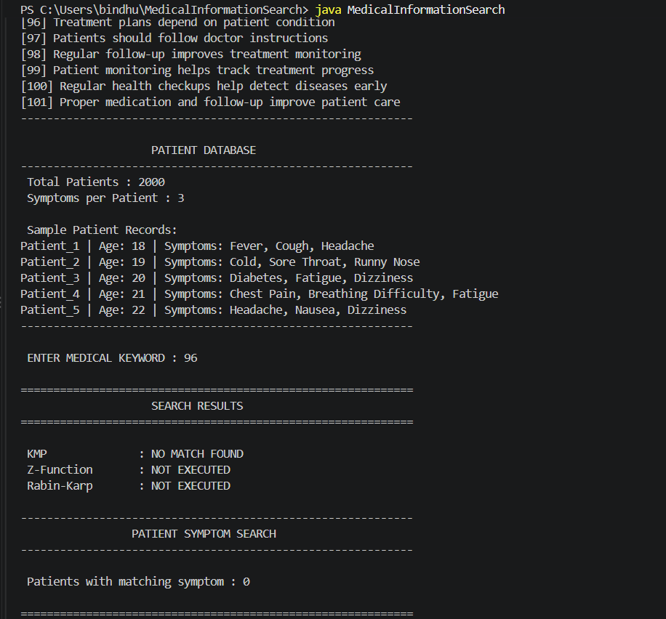
Results

Slide 9
Hardware and Software requirements
Hardware
Computer / Laptop
Minimum 4 GB RAM
Minimum 10 GB storage
Keyboard and Mouse
Software
Windows / Linux
Java
JDK
Visual Studio Code
Java Standard Library
Data Structures and Algorithms

Slide 10
Conclusion
The High-Performance Medical Information Search System provides a fast and efficient way to search medical information.
The system contains 100 medical records and 2,000 patient records for searching and testing.
KMP is used for searching medical records based on the entered keyword.
The system can search patient records based on their symptoms.
Dynamic Programming techniques such as Edit Distance, LCS, and 0/1 Knapsack are implemented.
The project demonstrates the practical application of Data Structures and Algorithms to a real-world medical search problem.
The system reduces the effort required to find relevant medical information.
Z-Function and Rabin-Karp are used to verify matching results.
Multiple searching techniques provide a useful basis for comparing and improving search performance.
The project can be extended to handle larger medical datasets in the future.
Overall, the system provides a foundation for developing an advanced medical information retrieval application.

Slide 11
Future Scope
Increase the medical corpus from the current dataset to a much larger collection.
Add semantic search to understand the meaning of user queries.
Implement Natural Language Processing (NLP) for better medical text understanding.
Add spelling correction for incorrectly entered medical keywords.
Use Edit Distance to find similar medical terms and possible corrections.
Add result ranking so that the most relevant medical records appear first.
Develop a web-based interface for easier access to the search system.
Add voice-based search so users can speak their medical queries.
Include filters for diseases, symptoms, treatments, medicines, and medical conditions.
Integrate reliable and verified medical literature into the search corpus.
Add advanced search techniques such as fuzzy matching and semantic similarity.
Develop a mobile application for convenient medical information searching.

Slide 12
Thank you

